Slide 1
Operating System

Slide 2
What is an Operating System?
A computer system has many resources (hardware and software), which may be require to complete a task.
The commonly required resources are input/output devices, memory, file storage space, CPU etc.
OS acts as a manager of the above resources and allocates them to specific programs and users as necessary for their task.
Operating system is nothing but a software that manages the hardware.

Slide 3
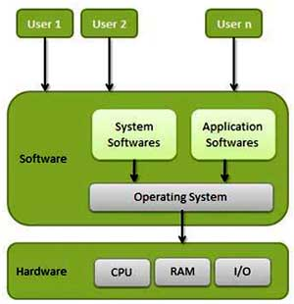
An operating System (OS) is an interface between users and computer hardware.

Slide 4
Functions of Operating System
Memory Management
Processor Management
Device Management
Security
Control over system performance
Job accounting
Error detecting aids
Coordination between other software and users

Slide 5
Memory Management
Memory management refers to management of Primary Memory or Main Memory.
Operating System does the following activities for memory management.
Keeps tracks of primary memory i.e. which part of it is in use and which part is not in use.
In multiprogramming, OS decides which process will get memory when and how much.
Allocates the memory when the process requests for it.
De-allocates the memory when the process no longer needs it or has been terminated.

Slide 6
Processor management
In multiprogramming environment, OS decides which process will get the processor and for how much time. This function is called process scheduling.
Operating System does the following activities for processor management.
Keeps tracks of the processor and status of the processes.
Allocates the processor(CPU) to a process.
De-allocates processor when processor is no longer required.

Slide 7
Device Management
OS manages device communication via their respective drivers.
Operating System does the following activities for device management.
Keeps tracks of all devices. Program responsible for this task is known as the I/O controller.
Decides which process gets the device when and for how much time.
Allocates the device in the efficient way.
De-allocates devices.

Slide 8
Other Important Activities
Following are some of the important activities that Operating System does.
Security : By means of password and similar other techniques, preventing unauthorized access to programs and data.
Control over system performance :Recording delays between request for a service and response from the system.
Job accounting :Keeping track of time and resources used by various jobs and users.
Error detecting aids : Production of dumps, traces, error messages and other debugging and error detecting aids.
Coordination between other software's and users :Coordination and assignment of compilers, interpreters, assemblers and other software to the various users of the computer systems.

Slide 9
Kernel
The kernel is the core of an operating system.
It is the software responsible for running programs and providing secure access to the machine's hardware
The sole aim of the kernel is to manage the communication between the software (user level applications) and the hardware (CPU, disk memory etc). The main tasks of the kernel are :
Process management
Device management
Memory management
Interrupt handling
I/O communication
File system...etc..

Slide 10
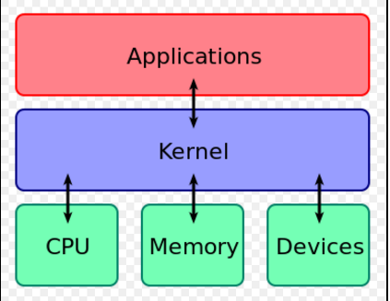
Steps To Load Kernel Into Memory
When we switch on computer, control will go to ROM, on which Bootstrap loader is present.
Job of bootstrap loader is to read 0th sector of hard disk, on which boot loader is present.
Job of boot loader is to load kernel in to memory.

Slide 11
Kernel Structure
When a process makes requests of the kernel, the request is called a system call .
Various kernel designs differ in how they manage system calls and resources.
Simple Kernel Structure
In this structure there is no distinguish between kernel mode & user mode.
All the programs can directly interact with OS & H/W.
Eg. DOS

Slide 12
Simple Kernel Structure

Slide 13
Monolithic Kernel
In this structure all the OS tasks(instructions) will run as one process in kernel mode.
And application program will run in user mode & can access services through system call interface.
Eg. Unix
Drawback: It will increase the size & complexity of kernal.
Microkernel
Instead of having all OS task running in kernel mode , only primitive task of OS will run in kernel mode with some abstraction over the H/W
And all other program/services of OS(networking, process mgmt, etc….) will run in user space.
Eg. MAC

Slide 14
Object Oriented Kernel / ExoKernel
Exokernel provide minimal abstractions, allowing low-level hardware access.
where the kernel is limited to extending resources to sub operating systems called LibOS's. Resulting in a very small, fast kernel environment.
In this OS tasks are designed in the form of modules, when ever required in future, those modules will be loaded in memory.
Hybrid Kernel Structure
(modified microkernels) are much like pure microkernels, except that they include some additional code in kernelspace to increase performance.

Slide 15
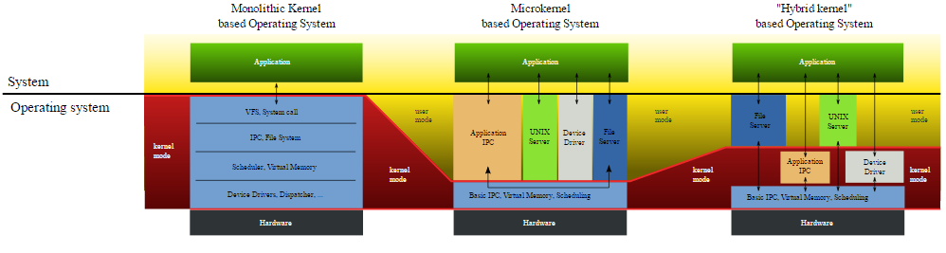

Slide 16
Types of Operating System:
Batch Operating System
Time-sharing Operating System
Distributed Operating System
Network Operating System
Real Operating System

Slide 17
Batch Operating System
In Batch operating system there is no interaction between user and the computer.
The user has to submit a job (written on cards or tape) to a computer operator.
Then computer operator places a batch of several jobs on an input device.
Jobs are batched together by type of languages and requirement.
Problems with Batch Operating System :
Lack of interaction between the user and job.
No mechanism to prioritize processes.

Slide 18
Time-sharing Operating System
A time sharing system allows many users to share the computer resources simultaneously.
The time sharing system provides the direct access to a large number of users where CPU time is divided among all the users on scheduled basis. The OS allocates a set of time to each user.
When this time is expired, it passes control to the next user on the system. The time allowed is extremely small and the users are given the impression that they each have their own CPU and they are the sole owner of the CPU.
This short period of time during that a user gets attention of the CPU; is known as a time slice or a quantum.

Slide 19
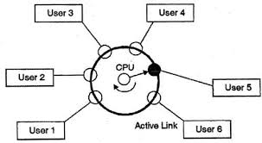
In above figure the user 5 is active but user 1, user 2, user 3, and user 4 are in waiting state whereas user 6 is in ready status.
As soon as the time slice of user 5 is completed, the control moves on to the next ready user i.e. user 6. In this state user 2, user 3, user 4, and user 5 are in waiting state and user 1 is in ready state. The process continues in the same way and so on.

Slide 20
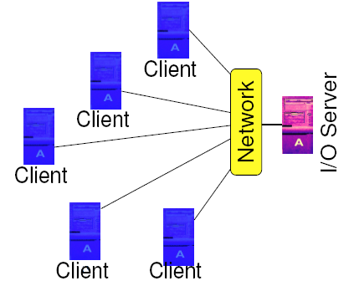
Distributed Operating System
Distributed means data is stored and processed on multiple locations.
Distributed systems
comprises of many
computers that are
inter connected by
communication networks.
The main benefit of
distributed systems is its low price/performance ratio.

Slide 21
The advantages of distributed systems are following.
With resource sharing facility user at one site may be able to use the resources available at another.
Speedup the exchange of data with one another via electronic mail.
If one site fails in a distributed system, the remaining sites can potentially continue operating.
Better service to the customers.
Reduction of the load on the host computer.
Reduction of delays in data processing.

Slide 22
Disadvantages of Distributed Operating System:
Security problem due to sharing
Some messages can be lost in the network system
Bandwidth is another problem if there is large data then all network wires to be replaced which tends to become expensive
Overloading is another problem in distributed operating systems
If there is a database connected on local system and many users accessing that database through remote or distributed way then performance become slow
The databases in network operating is difficult to administrate then single user system

Slide 23
Network operating System
Network Operating System runs on a server and and provides server the capability to manage data, users, groups, security, applications, and other networking functions.
The primary purpose of the network operating system is to allow shared file and printer access among multiple computers in a network, typically a local area network (LAN), a private network or to other networks

Slide 24
The advantages of network operating systems are following.
Centralized servers are highly stable.
Security is server managed.
Upgrades to new technologies and hardware's can be easily integrated into the system.
Remote access to servers is possible from different locations and types of systems.

Slide 25
Real time Operating System
In which the time interval required to process and respond to inputs is so small that it controls the environment.
It is always on line whereas on line system need not be real time.
So in this method response time is very less as compared to the online processing.
Real-time systems are used when there are rigid time requirements on the operation of a processor or the flow of data and real-time systems can be used as a control device in a dedicated application.
Real-time operating system has well-defined, fixed time constraints otherwise system will fail.
For example Scientific experiments, medical imaging systems, industrial control systems, weapon systems, robots, and home-appliance controllers, Air traffic control system etc.

Slide 26
What is process?
A process is a program in execution.
A process is the basic unit of execution in an operating system.

Slide 27
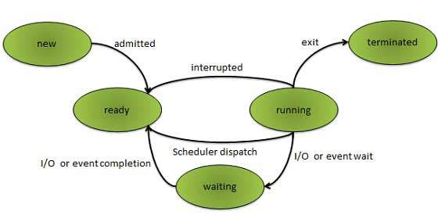
Process States
As a process executes, it changes state. The state of a process is defined as the current activity of the process.

Slide 28
New: The process is being created.
Ready: The process is waiting to be assigned to a processor. Ready processes are waiting to have the processor allocated to them by the operating system so that they can run.
Running: Process instructions are being executed (i.e. The process that is currently being executed).
Waiting: The process is waiting for some event to occur (such as the completion of an I/O operation).
Terminated: The process has finished execution.

Slide 29
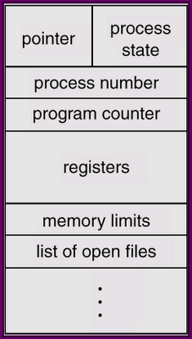
Process Control Block
Process Control block is used
for storing the collection of
information about the Processes .
This is also called as the data
structure which stores the
information about the process.
The information of the Process is
used by the CPU at the Run time.
PCB is also called as Task Control Block.

Slide 30
Pointer: Pointer points to another process control block. Pointer is used for maintaining the scheduling list.
Process ID: Each process is assigned a unique identification number, when it is entered into the system.
Process State : It indicates the information about the state of process such as new , ready , running etc.
CPU Registers : It indicates the information about the contents of the CPU registers.
The information of CPU registers must be saved when an interrupt occurs, so that the process can be continued correctly afterward.
Registers hold the processed the result of calculations or addresses pointing to the memory locations of desired data.
CPU Scheduling Information : It indicates the information needed for CPU scheduling such as process priority, pointers to scheduling queues and other scheduling parameters.

Slide 31
Context Switching
When OS have timer interrupt it will save the state of currently running process & will reload the state of next process to be executed.
This process of saving state & reloading the state actively in switching known as a context switching.

Slide 32
Process Scheduling
The act of determining which process in the ready state should be moved to the running state is known as Process Scheduling.
The prime aim of the process scheduling system is to keep the CPU busy all the time and to deliver minimum response time for all programs.
Job Queue. These queues will hold all newly created processes.
Ready Queue. These queues will hold all ready state process which are actively computing for CPU.
Device Queue. Every device will have its own device queue.
OS will keep all waiting process for that particular device in its device queue.
The process of selecting processes from (Job Queue, Ready Queue, Device Queue)among these queues is carried out by a scheduler.

Slide 33
Schedulers and Types of Scheduler
Schedulers are special system software's which handles process scheduling in various ways.
Their main task is to select the jobs to be submitted into the system and to decide which process to run.
Types of Scheduler
Long Term Scheduler
Short Term Scheduler
Medium Term Scheduler

Slide 34
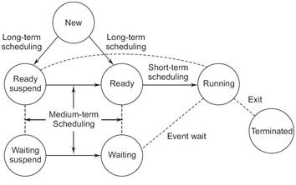
Scheduler

Slide 35
Long Term Scheduler
Long term scheduling is performed when a new process is created.
If the number of ready processes in the ready queue becomes very high, then there is a overhead on the operating system (i.e., processor) for maintaining long lists, context switching and dispatching increases. Therefore, allow only limited number of processes in to the ready queue.
The "long-term scheduler" manages this.
It selects the process from job queue & get that process in to the ready queue for the short-term scheduler.
In some systems, a newly created process begins in a swapped-out condition, in which case it is added to a queue for the medium-term scheduler.
scheduling manage queues to minimize queuing delay and to optimize performance.

Slide 36
Short Term Scheduler
Also called as CPU Scheduler.
It selects the process from ready queue & assign CPU to it.
It decides which of the ready, in-memory processes are to be executed (allocated a CPU) next following (a clock interrupt, an IO interrupt, an operating system call or another form of signal. )
Makes scheduling decisions much more frequently than the long-term or mid-term schedulers - a scheduling decision will at a minimum have to be made after every time slice, and these are very short.
Short term scheduler also known as dispatcher, execute most frequently and makes the fine grained decision of which process to execute next.
It is faster than long term scheduler.
The no of process in ready queue which are actively computing for CPU is known as degree of multiprogramming.

Slide 37
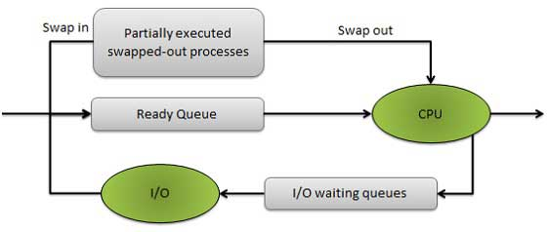
Middle Term Scheduler
The mid-term scheduler temporarily
removes processes from main memory
and places them on secondary memory
or vice versa. This is commonly referred
as "swapping out" or "swapping in" .
The mid-term scheduler may decide to swap out
a process which has not been active for some time,
a process which has a low priority, or
a process which is page faulting frequently, or
a process which is taking up a large amount of memory in order to free up main memory for other processes,
swapping the process back in later when more memory is available,
or when the process has been unblocked and is no longer waiting
for a resource.

Slide 38
Comparison between Scheduler
S.N. | Long Term Scheduler | Short Term Scheduler | Medium Term Scheduler
1 | It is a job scheduler | It is a CPU scheduler | It is a process swapping scheduler.
2 | Speed is lesser than short term scheduler | Speed is fastest among other two | Speed is in between both short and long term scheduler.
3 | It controls the degree of multiprogramming | It provides lesser control over degree of multiprogramming | It reduces the degree of multiprogramming.
4 | It is almost absent or minimal in time sharing system | It is also minimal in time sharing system | It is a part of Time sharing systems.
5 | It selects processes from pool and loads them into memory for execution | It selects those processes which are ready to execute | It can re-introduce the process into memory and execution can be continued.

Slide 39
Scheduling Criteria & Algorithm
Criteria
CPU Utilization
Throughput
Turnaround Time
Waiting Time
Response Time
Algorithm
First Come First Serve (FCFS) Scheduling
Shortest-Job-First (SJF) Scheduling
Priority Scheduling
Round Robin(RR) Scheduling

Slide 40
First Come First Serve (FCFS) Scheduling
FCFS also termed as First-In-First-Out i.e. allocate the CPU in order in which the process arrive.
When the CPU is free, it is allowed to process, which is occupying the front of the queue.
Once this process goes into running state, its PCB is removed from the queue.

Slide 42
Shortest-Job-First (SJF) Scheduling
Associate with each process the length of its next CPU burst. Use these lengths to schedule the process with the shortest time.
Two schemes:
non pre- emptive – once CPU given to the process it cannot be preempted until completes its CPU burst.
preemptive – if a new process arrives with CPU burst length less than remaining time of current executing process, preempt. This scheme is know as the Shortest-Remaining-Time-First (SRTF).

Slide 44
Priority Scheduling
Each process is assigned a priority. Process with highest priority is to be executed first and so on.
Processes with same priority are executed on first come first serve basis.
Priority can be decided based on memory requirements, time requirements or any other resource requirement.

Slide 45
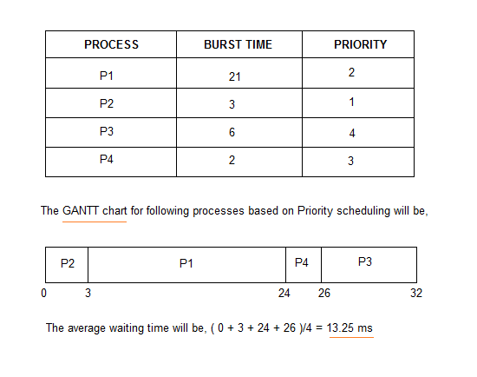
Priority Scheduling

Slide 46
Round Robin(RR) Scheduling
Each process is provided a fix time to execute called quantum.
Once a process is executed for given time period. Process is preempted and other process executes for given time period.
Context switching is used to save states of preempted processes.

Slide 47
Round Robin(RR) Scheduling
Example of RR with Time Quantum = 4
Process Burst Time
P1 24
P2 3
P3 3
The Gantt chart is:
P1 | P2 | P3 | P1 | P1 | P1 | P1 | P1
0 4 7 10 14 18 22 26 30

Slide 48
Thread
Thread is an execution unit which consists of its own program counter, a stack, and a set of registers.
Threads are also known as Lightweight processes.
Each thread belongs to exactly one process and no thread can exist outside a process.
Each thread represents a separate flow of control.

Slide 49
Difference between Process and Thread
S.N. | Process | Thread
1 | Process is heavy weight or resource intensive. | Thread is light weight taking lesser resources than a process.
2 | Process switching needs interaction with operating system. | Thread switching does not need to interact with operating system.
3 | In multiple processing environments each process executes the same code but has its own memory and file resources. | All threads can share same set of open files, child processes.
4 | If one process is blocked then no other process can execute until the first process is unblocked. | While one thread is blocked and waiting, second thread in the same task can run.
5 | Multiple processes without using threads use more resources. | Multiple threaded processes use fewer resources.
6 | In multiple processes each process operates independently of the others. | One thread can read, write or change another thread's data.

Slide 50
Types of Thread
Threads are implemented in following two ways-
User Level Threads -- User managed threads
Kernel Level Threads -- Operating System managed threads acting on kernel, an operating system core.

Slide 51
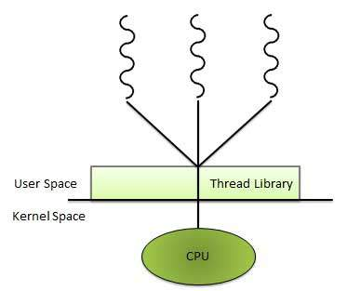
User Level Threads
In this case, application manages
thread management.
kernel is not aware of the existence
of threads.
The thread library contains code for
creating and destroying threads,
for passing message and data between
threads, for scheduling thread execution and for saving and restoring thread contexts.
The application begins with a single thread and begins running in that thread.

Slide 52
Advantages
Thread switching does not require Kernel mode privileges.
User level thread can run on any operating system.
Scheduling can be application specific in the user level thread.
User level threads are fast to create and manage.
Disadvantages
In a typical operating system, most system calls are blocking.

Slide 53
Kernel Level Threads
In this case, thread management done by the Kernel.
There is no thread management code in the application area.
Kernel threads are supported directly by the OS.
Any application can be programmed to be multithreaded. All of the threads within an application are supported within a single process.
The Kernel maintains context information for the process as a whole and for individuals threads within the process.
Scheduling by the Kernel is done on a thread basis. The Kernel performs thread creation, scheduling and management in Kernel space.
Kernel threads are generally slower to create and manage than the user threads.

Slide 54
Advantages
Kernel can simultaneously schedule multiple threads from the same process on multiple processes.
If one thread in a process is blocked, the Kernel can schedule another thread of the same process.
Kernel routines themselves can multithreaded.
Disadvantages
Kernel threads are generally slower to create and manage than the user threads.
Transfer of control from one thread to another within same process requires a mode switch to the Kernel.

Slide 55
Multithreading Models
Some operating system provide a combined user level thread and Kernel level thread facility.
Eg. Solaris
In a combined system, multiple threads within the same application can run in parallel on multiple processors and a blocking system call need not block the entire process.
Multithreading models are of three types
Many to many relationship.
Many to one relationship.
One to one relationship.

Slide 56
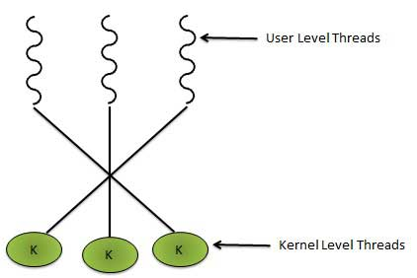
Many to Many Model
In this model, many user level threads multiplexes to the Kernel thread of smaller or equal numbers. The number of Kernel threads may be specific to either a particular application or a particular machine.
In this model, developers can create as many user threads as necessary and the corresponding Kernel threads can run in parallels on a multiprocessor.

Slide 57
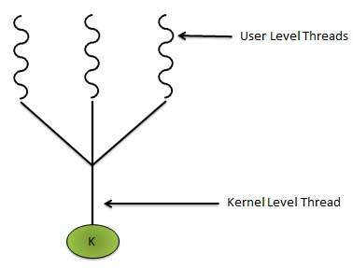
Many to One Model
Maps many user level threads to one Kernel level thread.
Thread management is done in user space.
When thread makes a blocking system call, the entire process will be blocked.
Only one thread can access the Kernel at a time, so multiple threads are unable to run in parallel on multiprocessors.

Slide 58
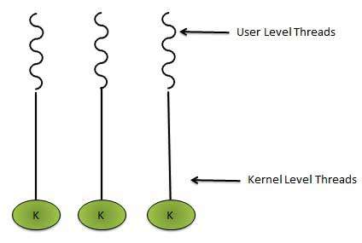
One to One Model
There is one to one relationship of user level thread to the kernel level thread.
This model provides more concurrency than the many to one model.
It also another thread to run when a thread makes a blocking system call. It support multiple thread to execute in parallel on microprocessors.
Disadvantage of this model is that creating user thread requires the corresponding Kernel thread. OS/2, windows NT and windows 2000 use one to one relationship model.

Slide 59
Difference between User Level & Kernel Level Thread
S.N. | User Level Threads | Kernel Level Thread
1 | User level threads are faster to create and manage. | Kernel level threads are slower to create and manage.
2 | Implementation is by a thread library at the user level. | Operating system supports creation of Kernel threads.
3 | User level thread is generic and can run on any operating system. | Kernel level thread is specific to the operating system.
4 | Multi-threaded application cannot take advantage of multiprocessing. | Kernel routines themselves can be multithreaded.

Slide 60
Process Synchronization
Process Synchronization means sharing system resources by processes in a such a way that, concurrent access to shared data is handled there by minimizing the chance of inconsistent data.
Maintaining data consistency demands mechanisms to ensure synchronized execution of cooperating processes.
Process Synchronization was introduced to handle problems that arise while multiple process executions. Some of the problems are discussed below.

Slide 61
Critical Section Problem
A Critical Section is a code segment that accesses shared variables and has to be executed as an atomic action.
It means that in a group of cooperating processes, at a given point of time, only one process must be executing its critical section.
If any other process also wants to execute its critical section, it must wait until the first one finishes.

Slide 62
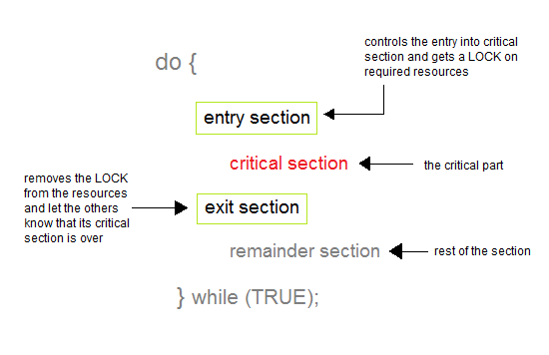

Slide 63
Solution to Critical Section Problem
A solution to the critical section problem must satisfy the following three conditions :
Mutual Exclusion: Out of a group of cooperating processes, only one process can be in its critical section at a given point of time.
Progress: If no process is in its critical section, and if one or more threads want to execute their critical section then any one of these threads must be allowed to get into its critical section.
Bounded Waiting: After a process makes a request for getting into its critical section, there is a limit for how many other processes can get into their critical section, before this process's request is granted. So after the limit is reached, system must grant the process permission to get into its critical section.

Slide 64
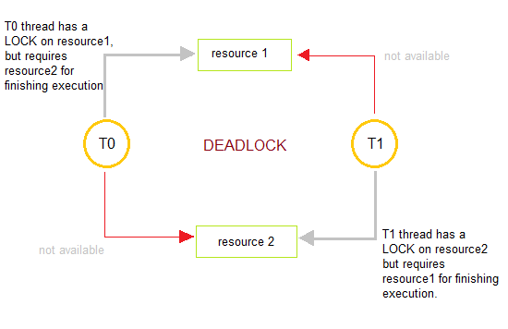
Deadlocks
Deadlocks are a set of blocked processes each holding a resource and waiting to acquire a resource held by another process.

Slide 65
How to avoid Deadlocks
Deadlocks can be avoided by avoiding at least one of the four conditions, because all this four conditions are required simultaneously to cause deadlock.
Mutual Exclusion: Resources shared such as read-only files do not lead to deadlocks but resources, such as printers and tape drives, requires exclusive access by a single process.
Hold and Wait: In this condition processes must be prevented from holding one or more resources while simultaneously waiting for one or more others.
No Pre-emption: Pre-emption of process resource allocations can avoid the condition of deadlocks, where ever possible.
Circular Wait: Circular wait can be avoided if we number all resources, and require that processes request resources only in strictly increasing(or decreasing) order.

Slide 66
Memory Management
Memory management is the functionality of an operating system which handles or manages primary memory.
Memory management keeps track of each and every memory location either it is allocated to some process or it is free.
It checks how much memory is to be allocated to processes. It decides which process will get memory at what time.
It tracks whenever some memory gets freed or unallocated and correspondingly it updates the status.

Slide 67
Dynamic Loading
In dynamic loading, a routine of a program is not loaded until it is called by the program.
All routines are kept on disk in a re-locatable load format.
The main program is loaded into memory and is executed.
Other routines methods or modules are loaded on request.
Dynamic loading makes better memory space utilization and unused routines are never loaded.

Slide 68
Dynamic Linking
At times one program is dependent on some other program.
In such a case, rather than loading all the dependent programs, CPU links the dependent programs to the main executing program when its required.
This mechanism is known as Dynamic Linking.

Slide 69
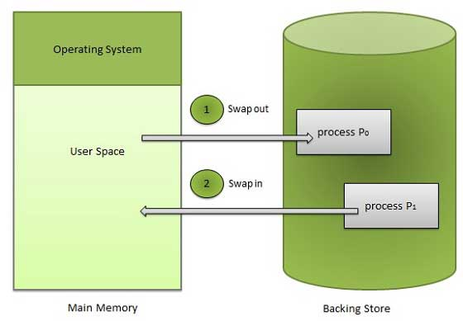
Swapping
A process needs to be in memory for execution. But sometimes there is not enough main memory to hold all the currently active processes in a timesharing system.
So, excess process are kept on disk and brought in to run dynamically.
Swapping is the process of bringing in each process in main memory, running it for a while and then putting it back to the disk.

Slide 70
Memory Allocation
Main memory usually has two partitions
Low Memory -- Operating system resides in this memory.
High Memory -- User processes then held in high memory.
Operating system uses the following memory allocation mechanism.
S.N. | Memory Allocation | Description
1 | Single-partition allocation | In this type of allocation, relocation-register scheme is used to protect user processes from each other, and from changing operating-system code and data.
2 | Multiple-partition allocation | In this type of allocation, main memory is divided into a number of fixed-sized partitions where each partition should contain only one process. When a partition is free, a process is selected from the input queue and is loaded into the free partition. When the process terminates, the partition becomes available for another process.

Slide 71
Fragmentation
Fragmentation occurs in a dynamic memory allocation system when most of the free blocks are too small to satisfy any request. It is generally termed as inability to use the available memory.
In such situation processes are loaded and removed from the memory. As a result of this, free holes exists to satisfy a request but is non contiguous i.e. the memory is fragmented into large no. Of small holes. This phenomenon is known as External Fragmentation.
Also, at times the physical memory is broken into fixed size blocks and memory is allocated in unit of block sizes. The memory allocated to a space may be slightly larger than the requested memory. The difference between allocated and required memory is known as Internal fragmentation i.e. the memory that is internal to a partition but is of no use.

Slide 72
Paging
External fragmentation is avoided by using paging technique. Paging is a technique in which physical memory is broken into blocks of the same size called pages (size is power of 2, between 512 bytes and 8192 bytes). When a process is to be executed, it's corresponding pages are loaded into any available memory frames.
Logical address space of a process can be non-contiguous and a process is allocated physical memory whenever the free memory frame is available. Operating system keeps track of all free frames. Operating system needs n free frames to run a program of size n pages.

Slide 73
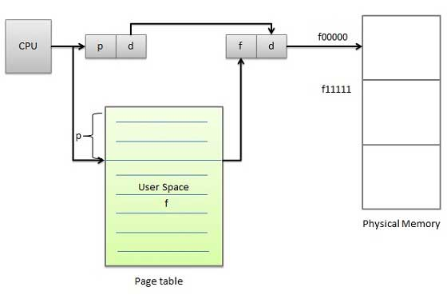
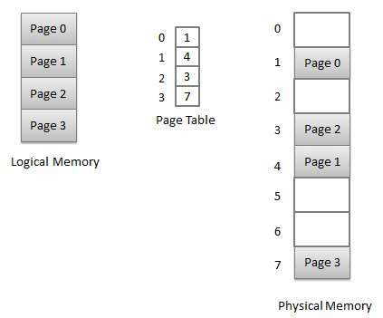
Address generated by CPU is divided into
Page number (p) -- page number is used as an index into a page table which contains base address of each page in physical memory.
Page offset (d) -- page offset is combined with base address to define the physical memory address.

Slide 74
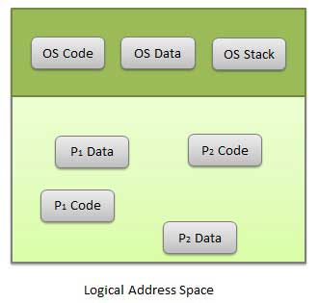
Segmentation
Segmentation is a technique to break memory into logical pieces where each piece represents a group of related information. For example ,data segments or code segment for each process, data segment for operating system and so on. Segmentation can be implemented using or without using paging.
Unlike paging, segment are having varying sizes and thus eliminates internal fragmentation. External fragmentation still exists but to lesser extent.

Slide 75
Address generated by CPU is divided into
Segment number (s) -- segment number is used as an index into a segment table which contains base address of each segment in physical memory and a limit of segment.
Segment offset (o) -- segment offset is first checked against limit and then is combined with base address to define the physical memory address.

Slide 76
File
A file is a named collection of related information that is recorded on secondary storage such as magnetic disks, magnetic tapes and optical disks.In general, a file is a sequence of bits, bytes, lines or records whose meaning is defined by the files creator and user.

Slide 77
File Structure
File structure is a structure, which is according to a required format that operating system can understand.
A file has a certain defined structure according to its type.
A text file is a sequence of characters organized into lines.
A source file is a sequence of procedures and functions.
An object file is a sequence of bytes organized into blocks that are understandable by the machine.
When operating system defines different file structures, it also contains the code to support these file structure. Unix, MS-DOS support minimum number of file structure.

Slide 78
File Access Methods
The way that files are accessed and read into memory is determined by Access methods. Usually a single access method is supported by systems while there are OS's that support multiple access methods.
There are several ways to access files
Sequential access
Direct/Random access
Indexed sequential access

Slide 79
Sequential access
A sequential access is that in which the records are accessed in some sequence i.e the information in the file is processed in order, one record after the other. This access method is the most primitive one. Example: Compilers usually access files in this fashion.
Direct/Random access
Random access file organization provides, accessing the records directly.
Each record has its own address on the file with by the help of which it can be directly accessed for reading or writing.
The records need not be in any sequence within the file and they need not be in adjacent locations on the storage medium.

Slide 80
Indexed sequential access
This mechanism is built up on base of sequential access.
An index is created for each file which contains pointers to various blocks.
Index is searched sequentially and its pointer is used to access the file directly.

Slide 81
Space Allocation
Files are allocated disk spaces by operating system. Operating systems deploy following three main ways to allocate disk space to files.
Contiguous Allocation
Linked Allocation
Indexed Allocation

Slide 82
Contiguous Allocation
Each file occupy a contiguous address space on disk.
Assigned disk address is in linear order.
Easy to implement.
External fragmentation is a major issue with this type of allocation technique.
Linked Allocation
Each file carries a list of links to disk blocks.
Directory contains link / pointer to first block of a file.
No external fragmentation
Effectively used in sequential access file.
Inefficient in case of direct access file.
Indexed Allocation
Provides solutions to problems of contiguous and linked allocation.
A index block is created having all pointers to files.
Each file has its own index block which stores the addresses of disk space occupied by the file.
Directory contains the addresses of index blocks of files.

